Slide 1
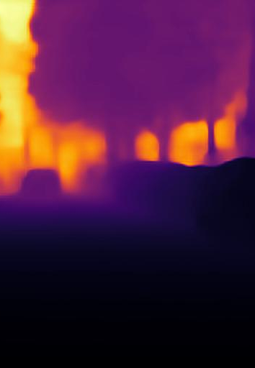
WeatherDepth: Monocular Depth Estimation in Adverse Weather Conditions with Adversarial Training
Final Project Video Demonstration
Project By:
Avishka Amunugama
Supervised By:
Thiloshon Nagarajah
Notes:
I am Avishka Amunugama and my research project is WeatherDepth which is a monocular depth estimation system to estimate depth in adverse weather conditions.

Slide 2
01 Problem Domain
The agenda
02 Research Gap
03 Research Aim
04 System Design & Architecture
05 Demonstration
06 Testing & Evaluation
07 Limitations & Future Work
08 Contribution to the body of knowledge
09 Conclusion
Notes:
This is the agenda of the presentation, and I will be starting with an overview of the problem domain.

Slide 3
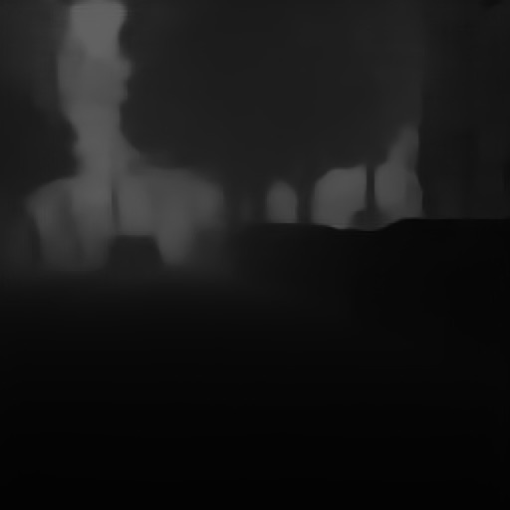
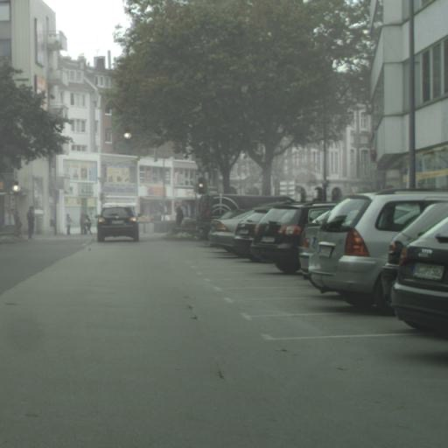
01 Problem Domain
What exactly is monocular depth estimation?
Converts a RGB image to a depth map.
Does not use any sensor data.
Widely used in vision guided robots, AR systems, and on self-driving vehicles.
Notes:
So, what exactly is monocular depth estimation?
When a picture is taken from a normal colored camera, a 2D representation of the scene is captured but the depth information of the scene is lost. Monocular depth estimation allows us to obtain this lost depth information of the scene which can help us understand the spatial structure of the actual scene the image captured from without using any additional sensor data.
Therefore, monocular depth estimation is the task of converting an RGB image captured from a simple colored camera into a depth map with a mapping of depth at every point in it. Essentially what it does is, it converts a normal 2D image of a scene, as the one shown on the right
[click] Next slide
to a grayscale representation of a depth map like this.
This is widely used in many industries such as in vision-guided robots and drones, augmented reality systems and for self-driving vehicles where in recent years most of the research in monocular depth estimation has been done in relation to.

Slide 4
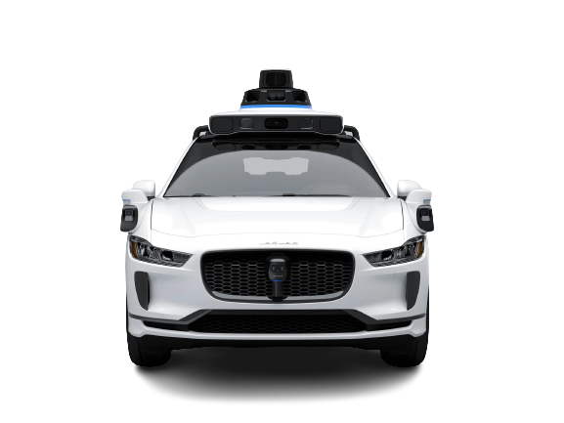
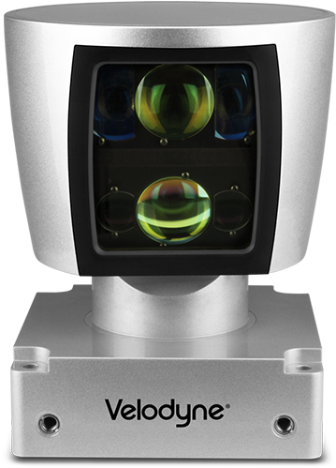
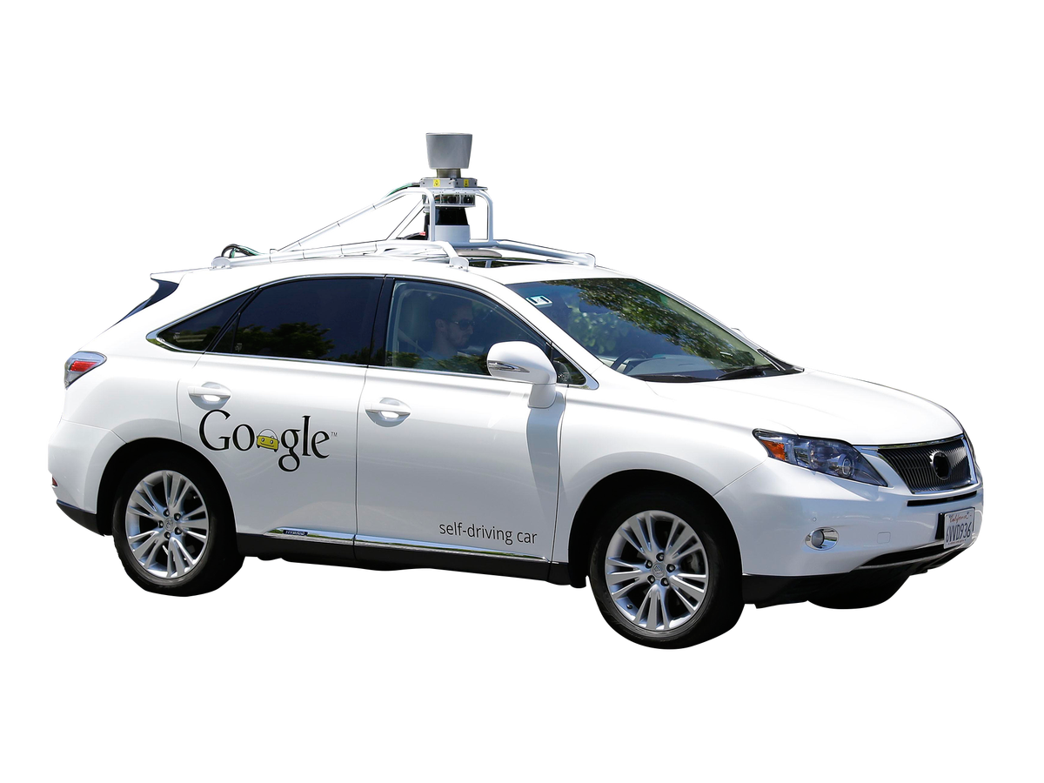
01 Problem Domain
Why is monocular depth estimation important for self-driving cars? Aren’t they already using lidar sensors for that purpose?
Lidar is extremely expensive.
Lidar is bulky.
Cameras are cheap and readily available.
Best monocular approaches perform close to sensor-based approaches.
Notes:
So why is monocular depth information important for autonomous vehicles? Aren't they already using sophisticated sensors such as lidar for estimating depth of the surrounding?
Yes, most companies researching and developing self driving vehicle currently use sensor-based approaches. The most prominently used sensor for depth estimation currently is the lidar sensor which spins on top of vehicles and captures a point cloud of the environment it is in by projecting laser beams.
But it has 2 major drawbacks
- It is extremely expensive - autonomous vehicle companies find it difficult to use in mass production
- and they are bulky - should be mounted on rooftops for them to work efficiently which is a huge hit on car aesthetics.
So due to these drawbacks autonomous industry has started looking into alternative ways to capture depth information.
And that's where monocular depth estimation comes into the play.

Slide 5
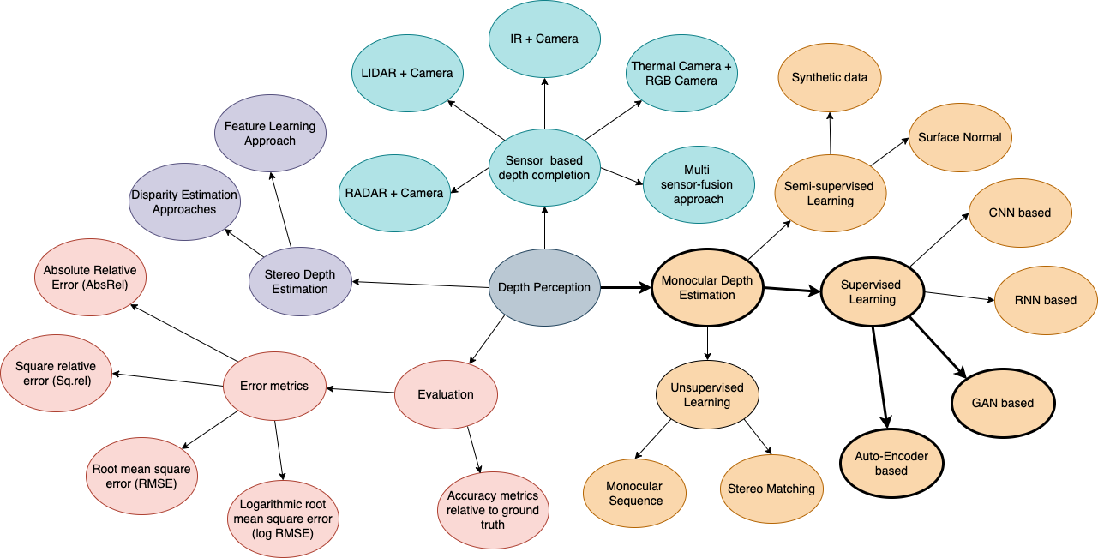
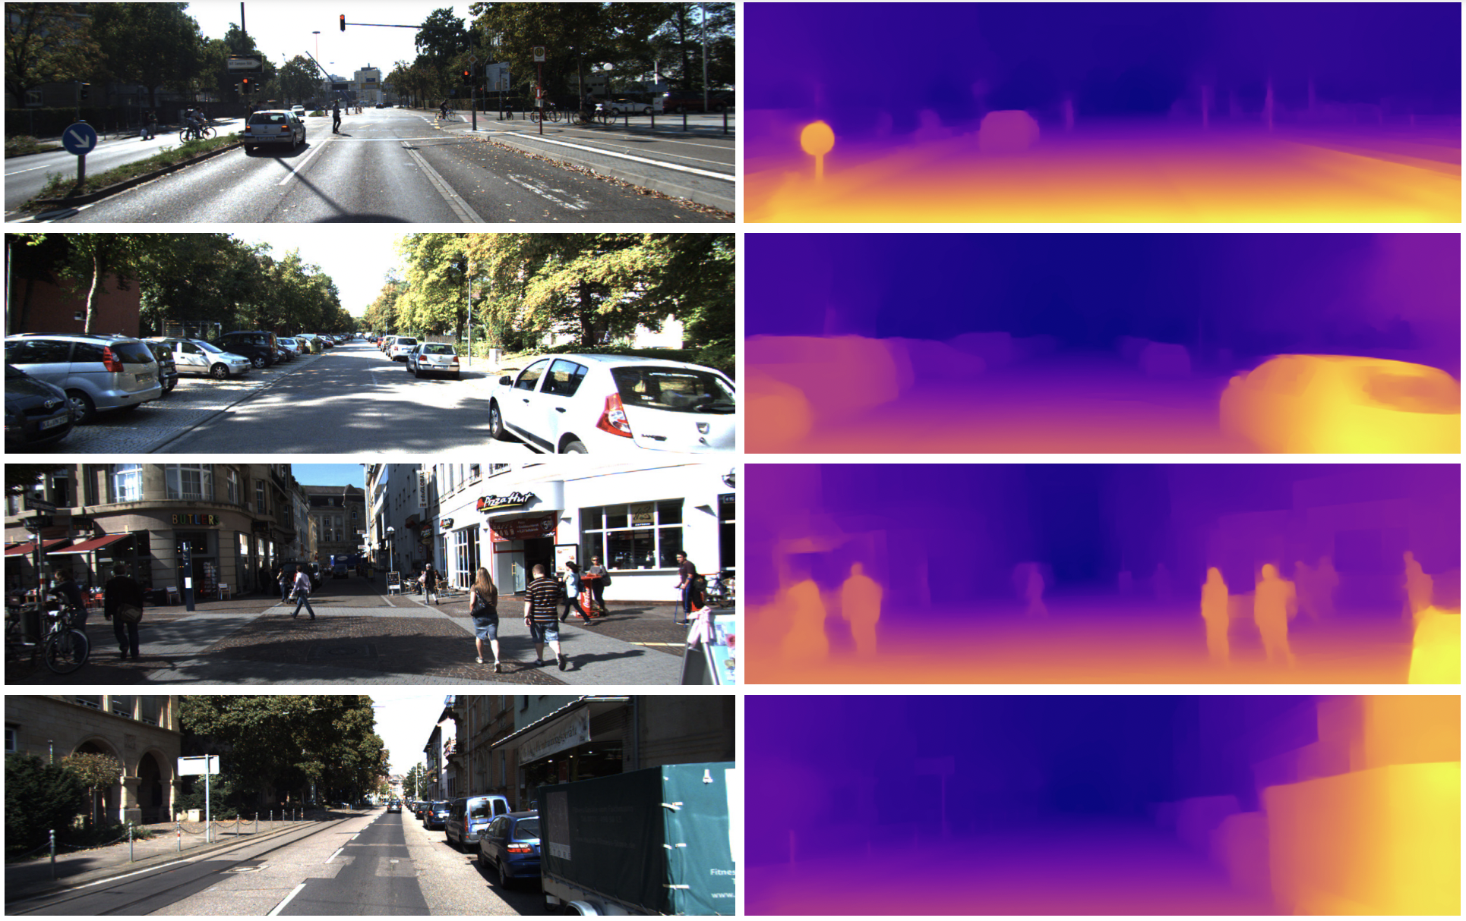
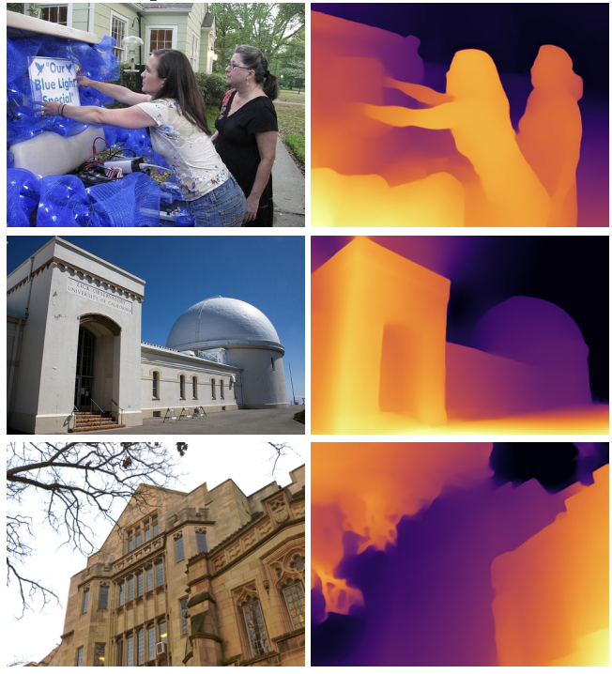
Related work and concept map of the problem domain
Recent state-of-the-art monocular depth estimation approaches produce outstanding results.
(Alhashim and Wonka, 2019) DenseDepth
(Ranftl et al., 2020) MiDAS
Notes:
Shown here are some depth estimates produced from the best-performing state-of-the-art monocular depth estimation approaches. Shown on the left side of the screen is DenseDepth an autoencoder-based monocular depth estimation system. Shown on the right is Midas a vision transformer-based architecture and it is the best performing monocular depth estimation approach to-date. As it can be seen from these results the depth estimates produced by these approaches are very accurate and are extremely close to what's produced from sensor-based approaches.
[click] Next slide
This is the concept map of the problem domain. Previous monocular depth estimation approaches have been built using supervised, unsupervised, and semi-supervised learning paradigms depending on the nature of the available data. Out of these 3 learning paradigms, supervised approaches perform the best. Two of the most popular architectures being used in supervised approaches are auto-encoders and GANs which were heavily explored in this research. To evaluate the depth estimation models, most commonly used error metrics are Absolute relative error, squared relative error, root mean squared error, logarithmic root mean squared error and thresholded accuracy metrics as illustrated in the diagram.

Slide 6
So, what's stopping most autonomous driving communities from completely moving on to camera-based depth estimation approaches?
Notes:
As I've explained so far, current state-of-the-art monocular depth estimation approaches work great. But still, most autonomous vehicle development companies prefer sensor-based approaches over camera-based ones. So, what exactly is stopping most companies from completely moving on to camera-based approaches?

Slide 7
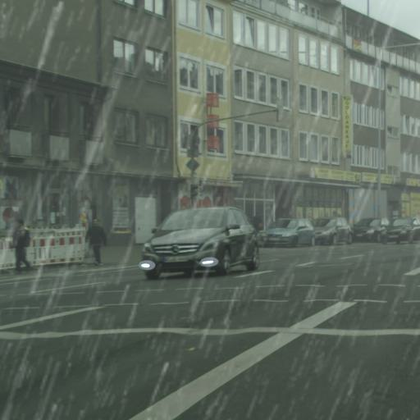
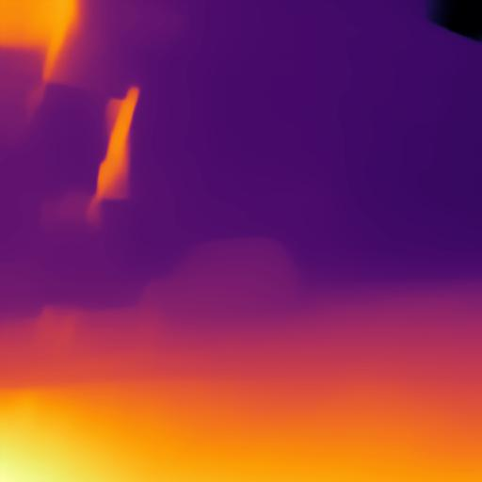
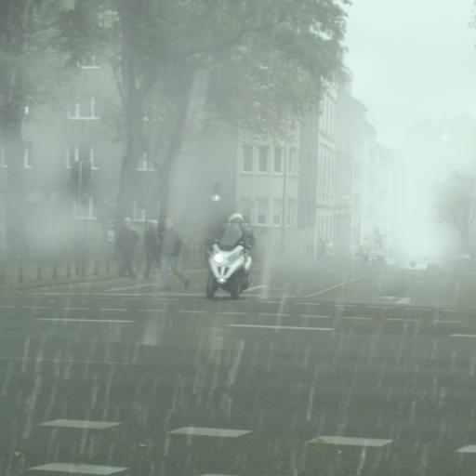
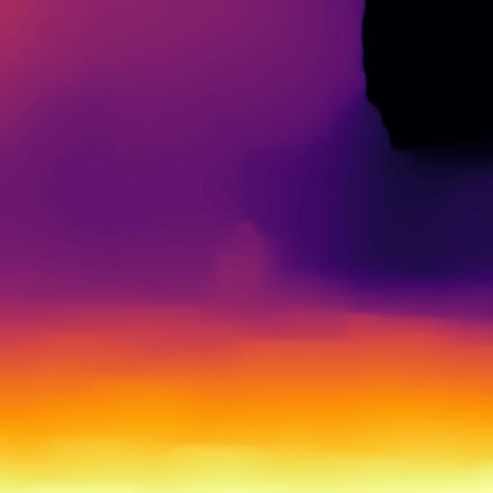
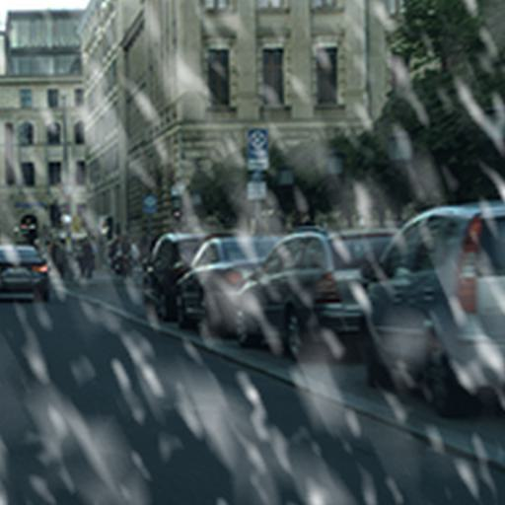
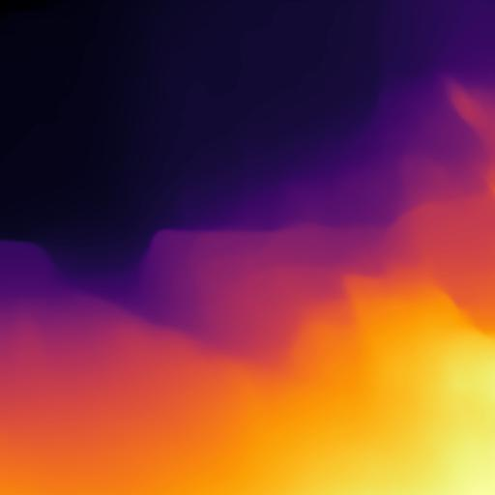
02 Research Gap
Current state-of-the-art monocular depth estimation approaches are built mainly focusing only on clear daytime conditions.
Most fail to maintain accuracy and consistency when subjected to adverse weather conditions such as rain, snow and fog.
Obtained by using the (Ranftl et al., 2020)
MiDAS v3 - large pretrained model.
Notes:
With extensive review of existing literature and study of the state-of-the art monocular depth estimation approaches it was found that the current state-of-the-art approaches were built only focusing on clear daytime conditions and even though they perform significantly well in clear weather they fails to maintain accuracy and consistency when subjected to adverse weather conditions such as rain, snow and fog.
This has been a major setback for camera-based depth estimations approaches and it is one of the main factors that is avoiding most autonomous vehicle development companies from moving on to camera-based approaches.
To the best my knowledge at the time of this research only 2 researches were published that attempted to address depth estimation in adverse weather conditions through a monocular camera setting. This shows that monocular depth estimation in adverse weather is a largely under-explored domain and very less attention has been shed on the topic. Testing it and other clear weather state-of-the-art monocular depth estimation approaches in the most commonly occurring adverse weather conditions which are rain, snow and fog it was evident that there is much room for improvement.

Slide 8
03 Research Aim
“The research aims to design, develop and evaluate a solid monocular depth estimation approach that can produce consistent and accurate depth estimates when subjected to various adverse weather conditions such as rain, snow, and fog, unlike most state-of-the-art methods, which fail to maintain accuracy and consistency when subjected to adverse weather.“
Notes:
The aim of this research is to design, develop and evaluate a robust monocular depth estimation approach that can produce consistent and accurate depth estimates when subjected to the most commonly occurring adverse weather conditions such as rain, snow, and fog. Unlike most state-of-the-art methods, which fail to maintain accuracy and consistency when subjected to adverse weather.

Slide 9
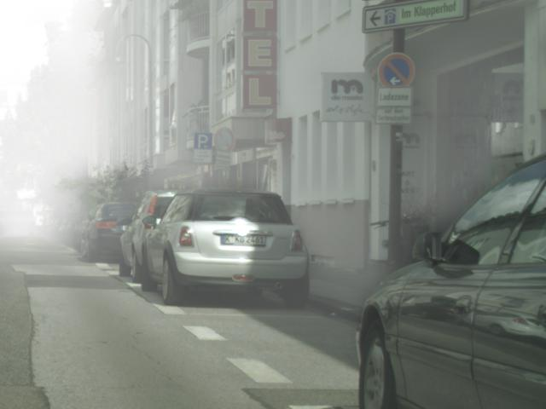
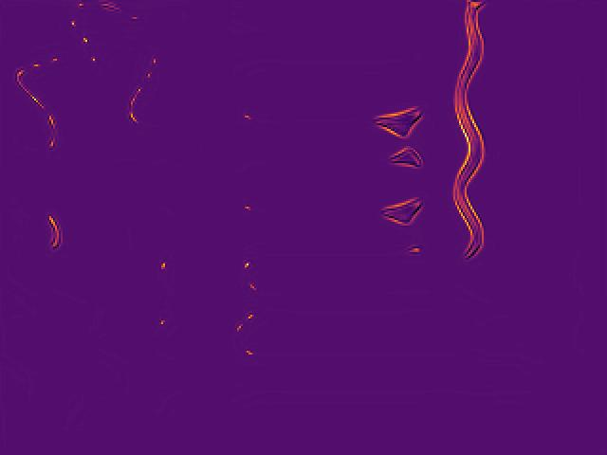
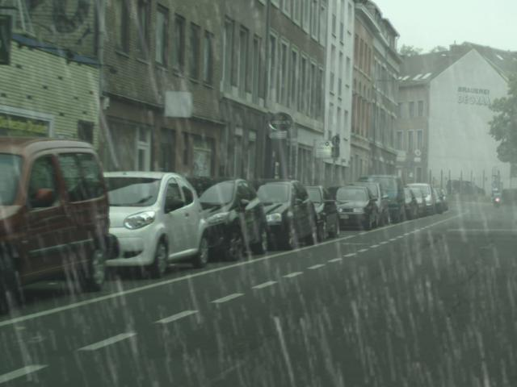
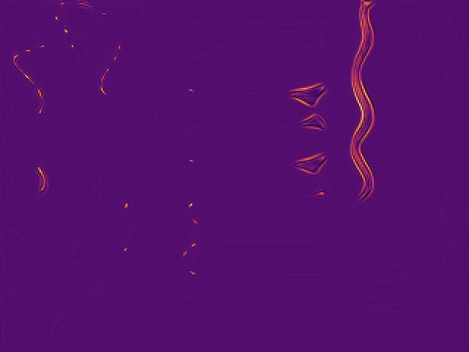
04 System Design & Architecture
Most of the network’s state-of-the-art daytime clear weather depth estimation networks utilized autoencoders.
But training on CityScapesWeather Dataset caused the autoencoders along to produce blurry washed-out output.
Other network architectures such as GANs were then tested.
Training with GANs caused mode collapse.
Notes:
As it was mentioned earlier both autoencoders and GANs were heavily explored during this research in order to implement the proposed approach. Initially, an autoencoder-based approach was tried out with my dataset consisting of rain, snow, and fog augmented weather images. The results obtained were washed out and blurry due to the reconstruction loss which is utilized in the network causes the pixels to average over the surrounding.
Then a GAN-based approach was tried out. After training for some epochs with this approach it was noticed that the model suffers from mode collapse, where the generator continuously learns a mapping function to fool the discriminator by producing the same output for any input image.
The pair of images shown below are once suffering from mode collapse.

Slide 10
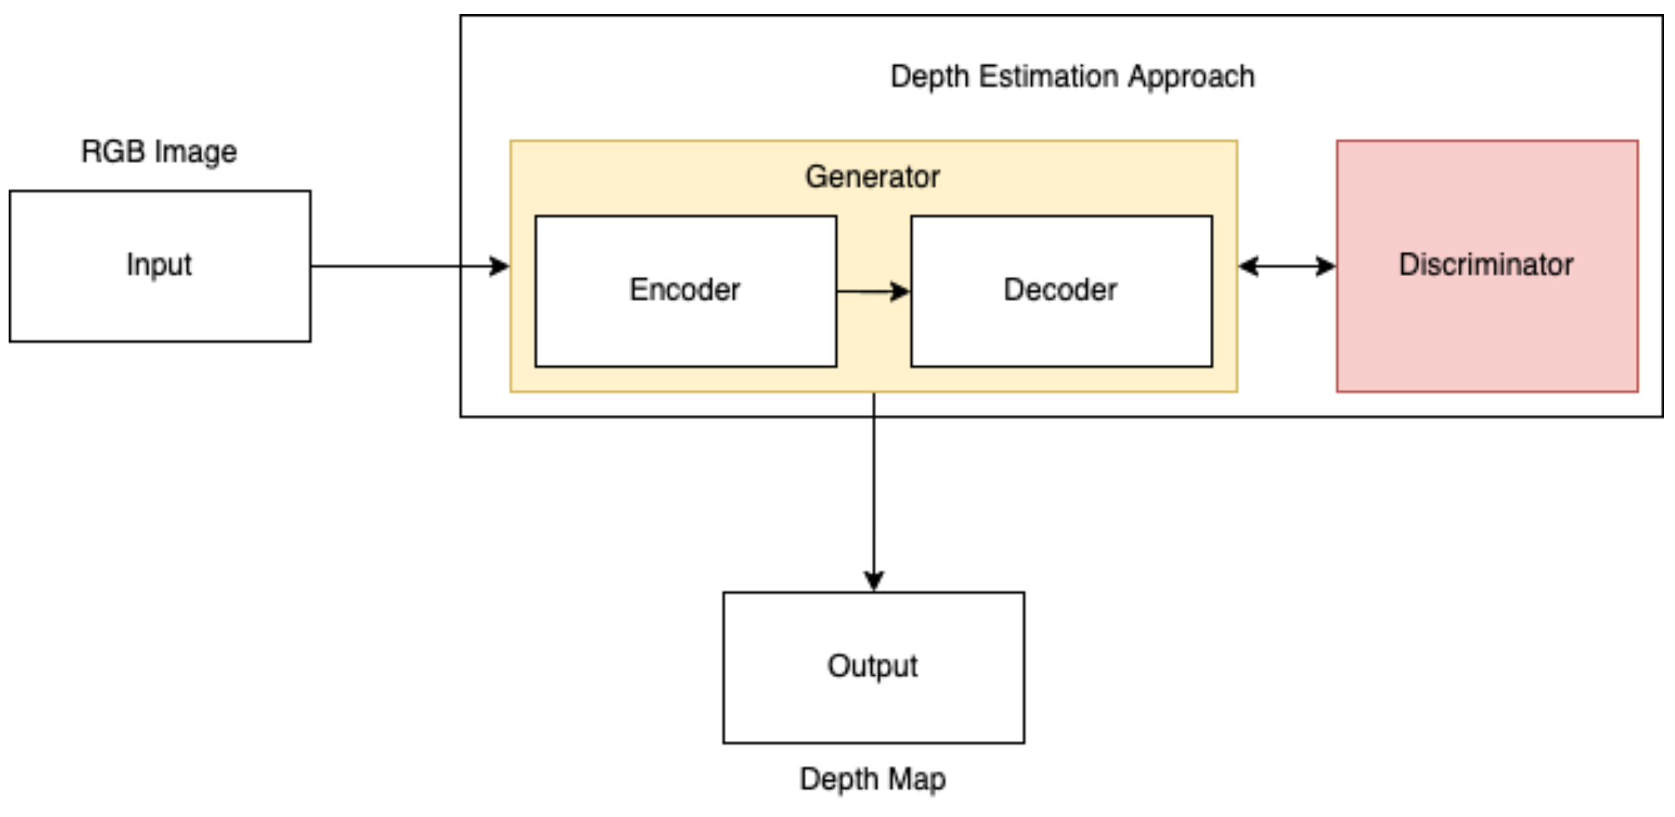
04 System Design & Architecture
Proposed architecture = GAN + autoencoder
Notes:
So, in order to overcome issues introduced by both these networks architectures, it was attempted to train the autoencoder adversarially so that whenever the autoencoder produces blurry, washed-out output, it will be picked up by the discriminator, and a significant loss value will be added to the overall loss function penalizing the result causing the autoencoder to improve further.
The results produced from this approach were significantly better, more accurate, and consistent with all weather conditions. Seen here is the diagram of the proposed architecture. It consists of 3 networks, an encoder, decoder, and discriminator. The encoder and decoder combined with skip connections act as the generator for the GAN.
A variety of loss functions and discriminators were tested and configurations that gave the best results were chosen. For the generator, a combined loss function of SSIM, L1, and GAN loss was used and as the discriminator for the network, a patch discriminator was used. More information regarding the results obtained with various loss functions and discriminators was explained in the thesis.

Slide 11
05 Demonstration of the Prototype

Slide 12
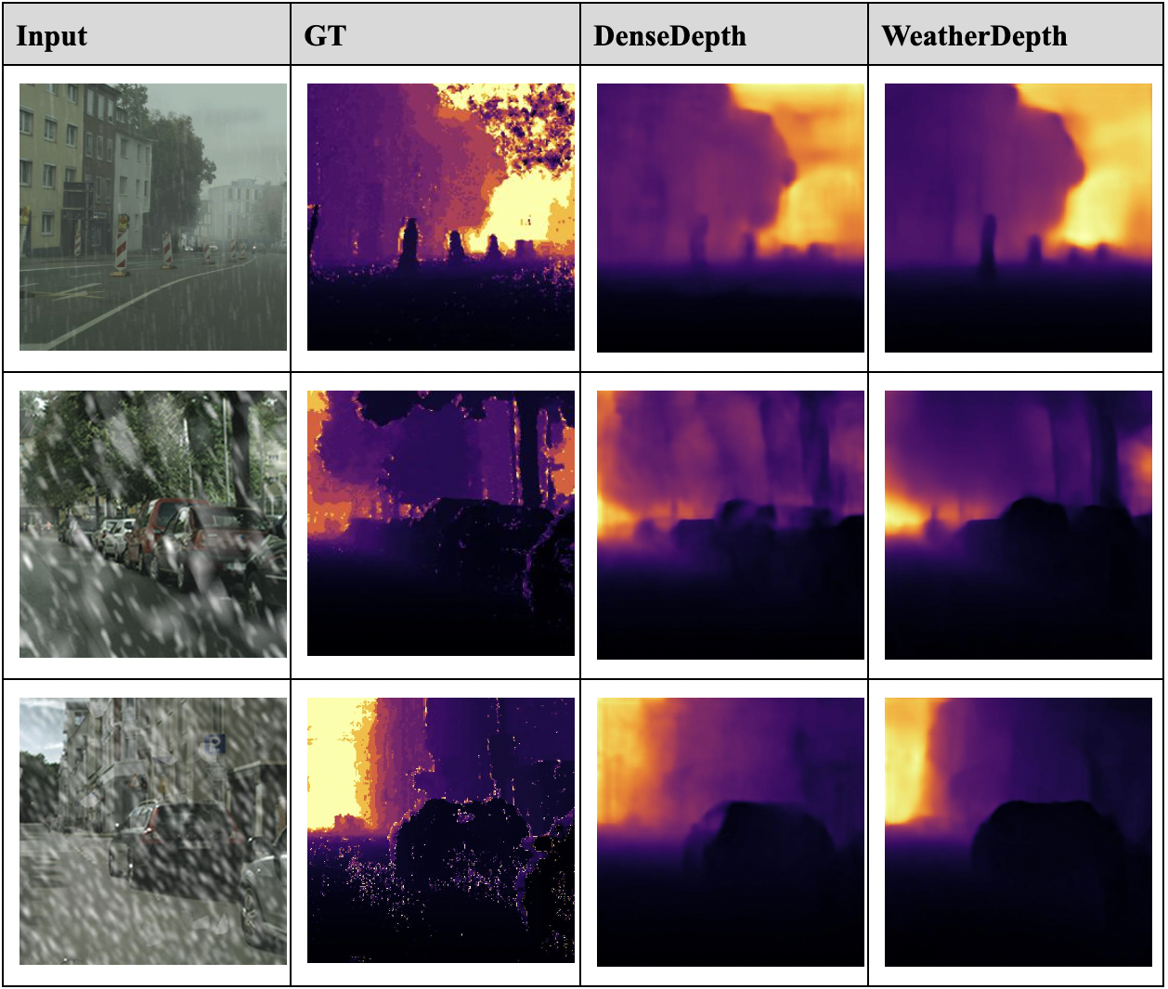
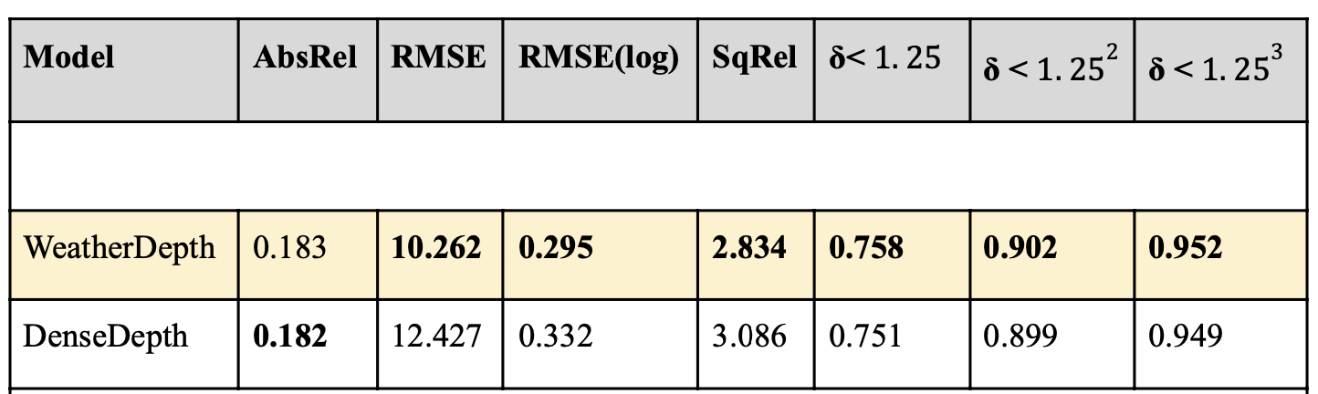
06 Testing & Evaluation (CityscapesWeather Dataset)
Notes:
In order to test and evaluate the model against state-of-the-art approaches, testing and evaluation was carried out with 2 datasets. Shown here are the results obtained by a well-performing autoencoder-based state-of-the-art approach known as DenseDepth against the approach proposed in this research, called Weatherdepth. As it can be seen WeatherDepth model is capable of identifying small objects such as the traffic barricades in the first image row and the overall shapes of objects better than the state-of-the-art.
The table on the right shows the results obtained by both models with commonly used evaluation metrics which I explained previously in the presentation. As it can be seen from the results in the table, the Weatherdepth model was outperforming DenseDepth in all error metrics except for absolute relative error in which the DenseDepth model was outperforming ours with a very small margin. Accuracy metrics wise our model outperformed the DenseDepth model in all 3 criteria.

Slide 13
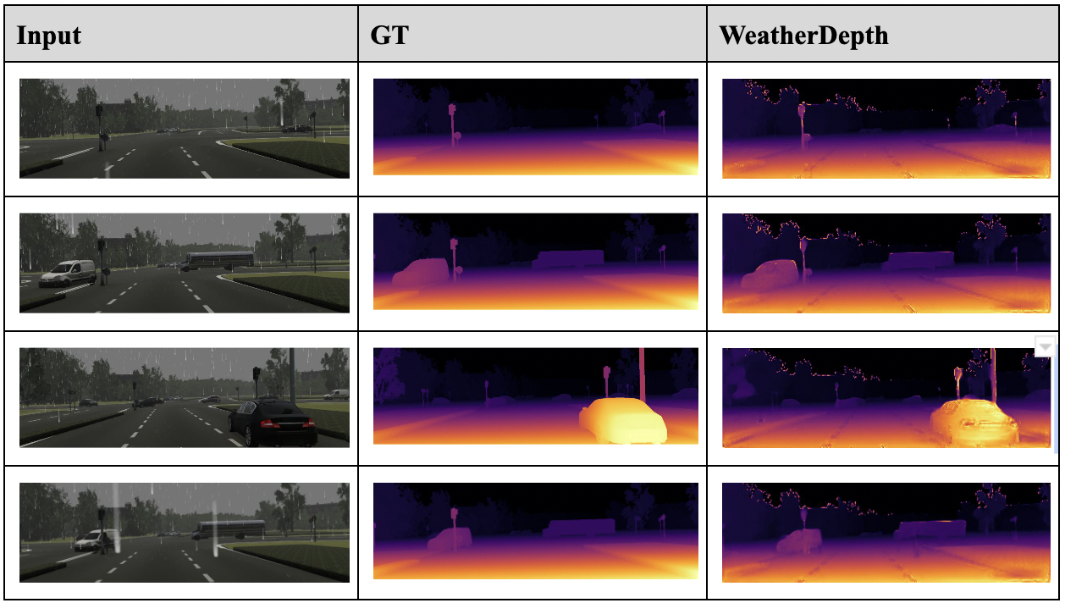
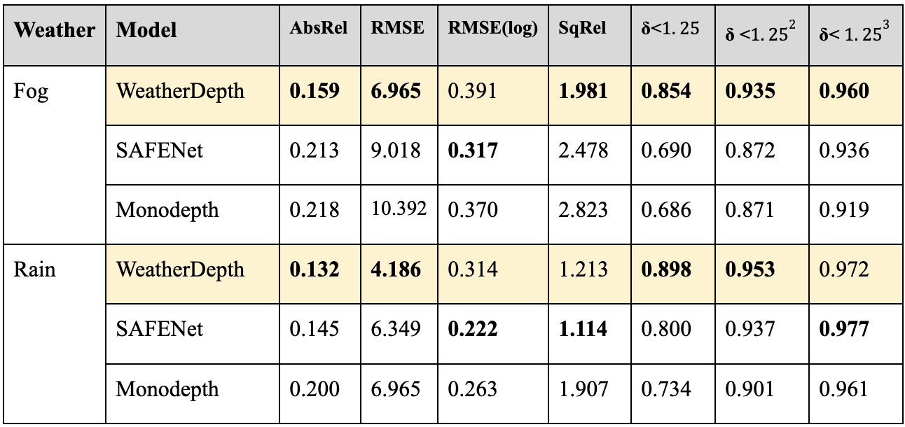
06 Testing & Evaluation (vKITTI Dataset)
Notes:
The table on the left shows the depthmaps produced by our approach WeatherDepth on vKITTI dataset which is a publicly available virtual dataset that has images of rain and fog conditions.
The table on the right shows the results for various error and accuracy metrics of our approach against the state-of-the-art approaches that had attempted monocular depth estimation in adverse weather conditions. WeatherDepth model was outperforming the rest of the approaches in all error and accuracy metrics except for logarithmic root mean squared error with fog images and with rain images Weatherdepth gave better results with absolute relative error and root mean squared error while SafeNet was performing better in logarithmic RMSE and squared relative error. In accuracy metrics, WeatherDepth was outperforming the rest of the approaches in 2 criteria except for 1.25 cube thresholded accuracy metric.

Slide 14
07 Limitations & Future Work
The limitation of Apple’s NSImage framework to represent images in float format, caused point cloud representation to be of lower resolution.
Tightly scoped to adverse weather due to limited time.
It would be interesting to see how the depth estimation system functions on clear weather images and how well it would compete against state-of-the-art clear depth estimation approaches.
Notes:
A major limitation faced during implementation was that NSImage framework provided by swift to hold image data represent data in integer format this resulted in a loss of quality in the point cloud representation of the image as all float depth estimates were truncated to integer values, this is said to be addressed in upcoming updates from Apple.
Due to time constraints, the project only focused on addressing adverse weather, as future work it would be interesting to expand the scope to include low light conditions as well.
Also, as future work, it would be interesting to see how the proposed approaches perform with clear weather data and how well it would complete against the state-of-the-art depth estimation approaches on clear weather conditions.

Slide 15
08 Contributions to the body of knowledge
This research made 3 important contributions to the body of knowledge.
A novel adversarially trained autoencoder-based architecture for robust monocular depth estimation in adverse weather conditions.
An optimal combined loss function for the task of monocular depth estimation in adverse weather conditions.
A new large-scale dataset with augmented ultra-realistic adverse weather images and ground truth data for monocular depth estimation in adverse weather conditions.
Notes:
This research made 3 important contributions to the body of knowledge, they are:
1 …….
2 ……
3 ……

Slide 16
09 Conclusion
A monocular depth estimation approach that can produce significantly better depth estimates in adverse weather conditions than the state-of-the-art approaches was successfully developed and evaluated.
With enough data camera-based approaches can perform equally as well or even better than sensor-based approaches with the help of deep learning.
Ultimately helps bring the autonomous industry one step closer to achieving full autonomy using only camera-based approaches.
Notes:
So in conclusion, this research introduced a new monocular depth estimation approach that can produce consistent and accurate depth estimates in all the frequently occurring adverse weather conditions without any major performance degradations and proves the point that with enough data camera-based approaches can be a viable alternative to sensor-based approaches ultimately helping bring the autonomous industry one step closer to achieving full autonomy and to be released to the public.

Slide 17
Thanks!
Notes:
So that's the end of the presentation thanks for listening.

